Slide 1
物聯網實務 HW4
電機碩一 11278008 林佳慧
日期:2023/10/04

Slide 2
Exercise 4-1
Test Object.keys() in Node-RED

Slide 3
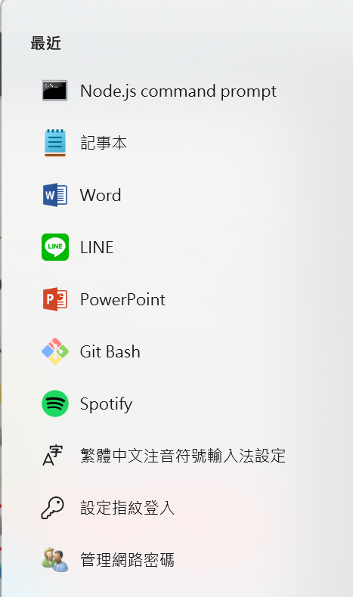
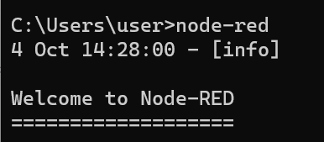
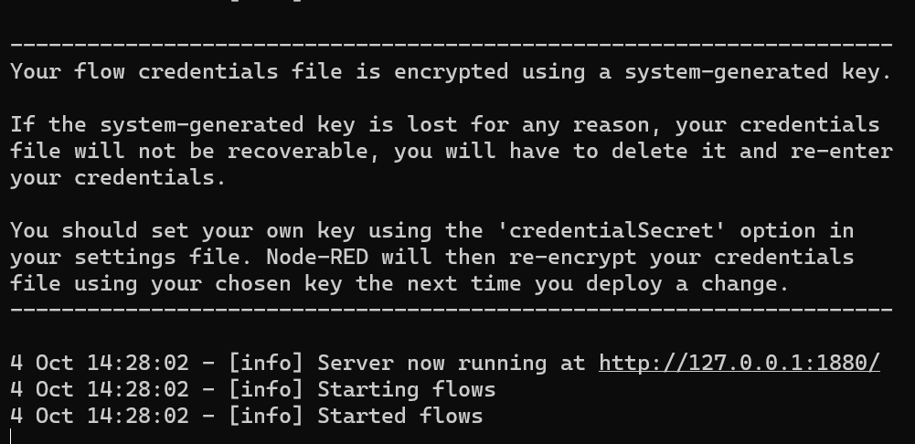
Open and run Node-RED
Ctrl + 滑鼠左鍵開啟網頁

Slide 4
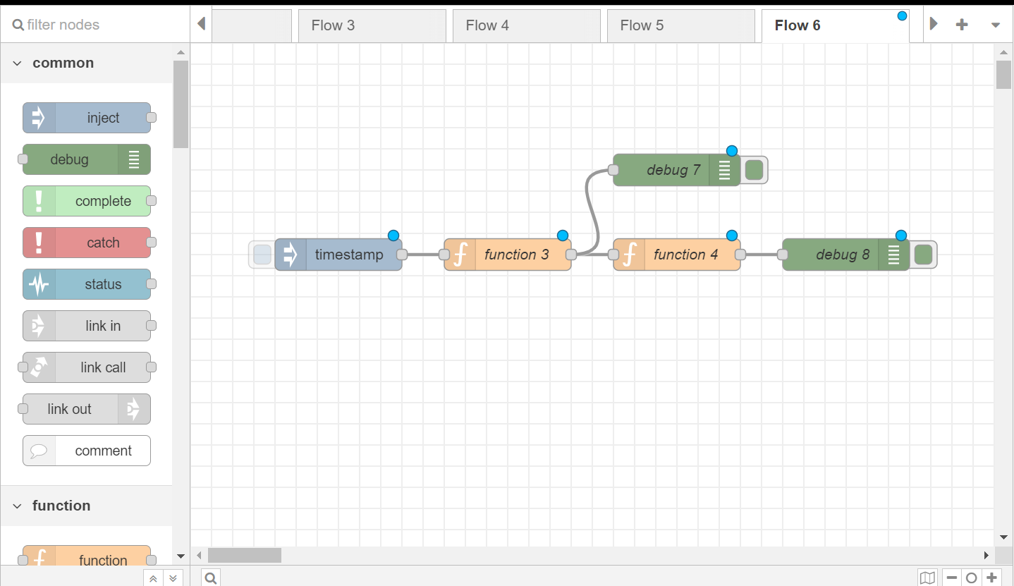
從左側拉node並接線

Slide 5
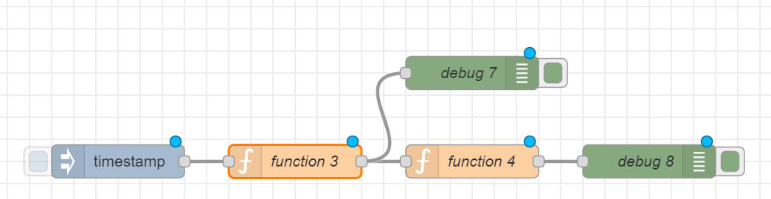
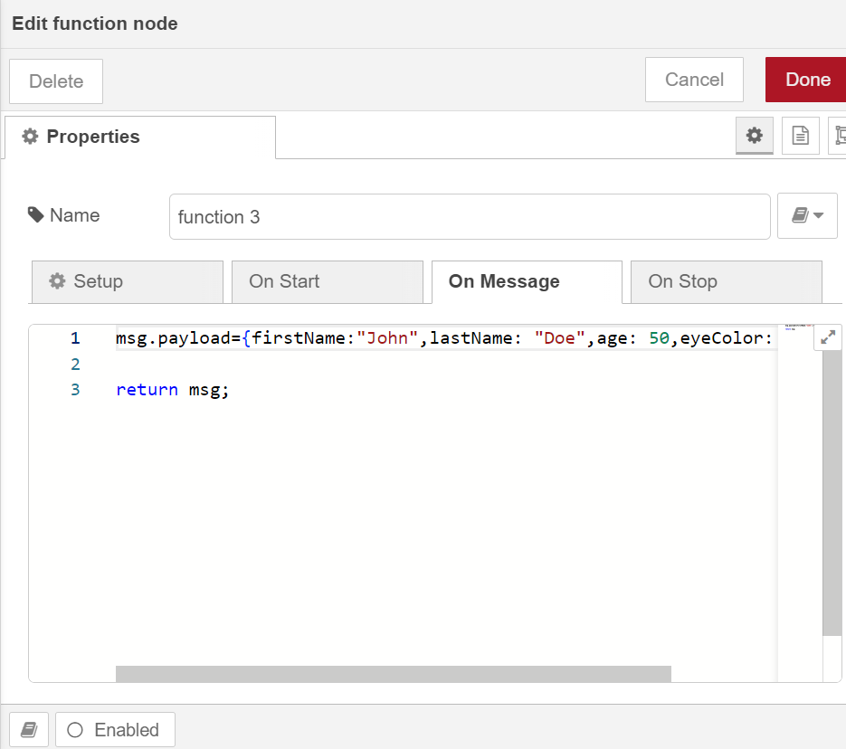
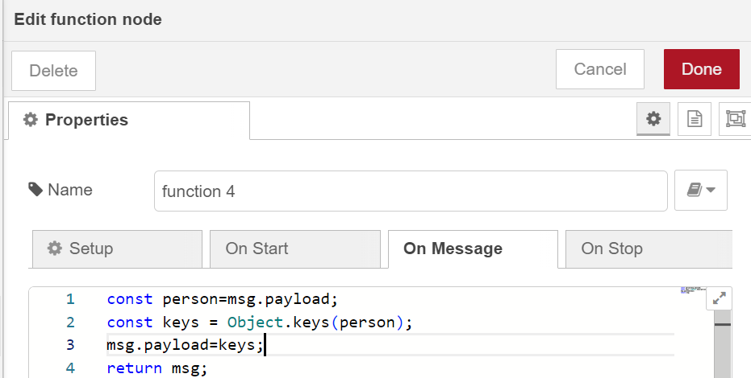
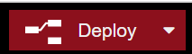
1
1
2
3

Slide 6
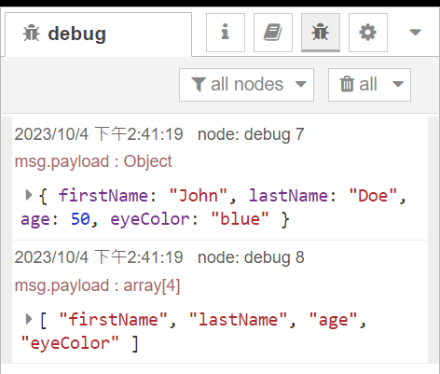
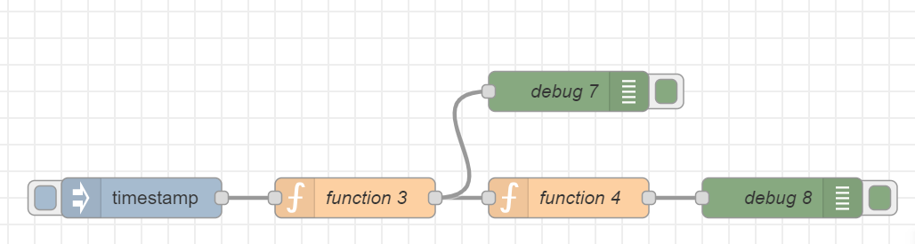
Trigger
click

Slide 7
Exercise 4-2
Test Object.values() in Node-RED

Slide 8
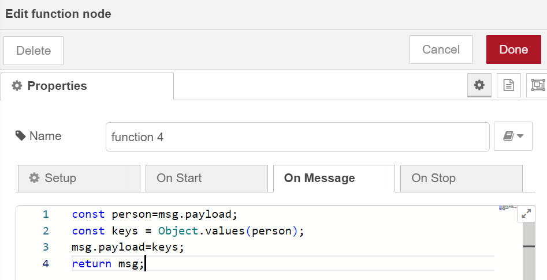
3
4
2
1

Slide 9
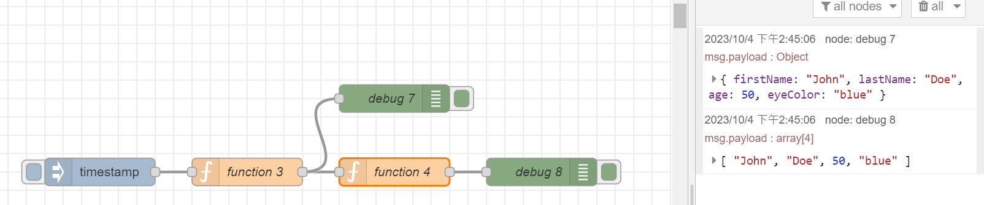
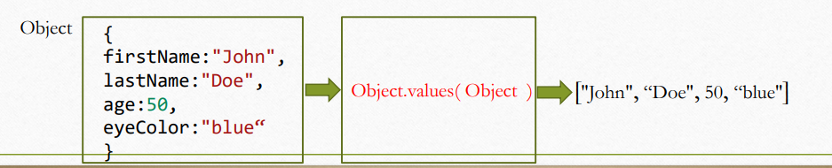

Slide 10
Exercise 4-3
Design of a voting system

Slide 11
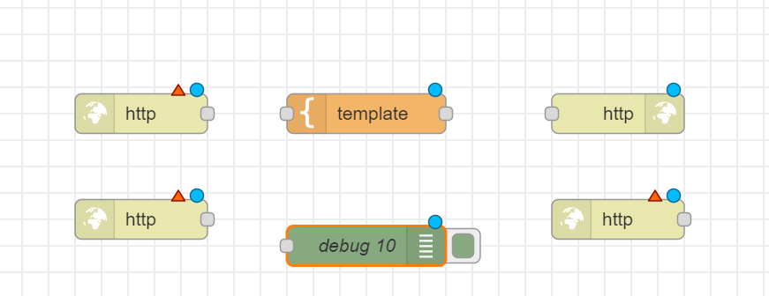

Slide 12
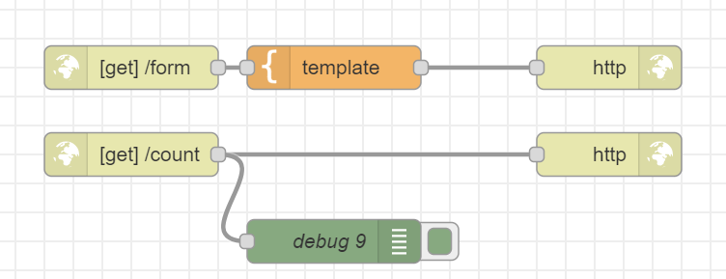
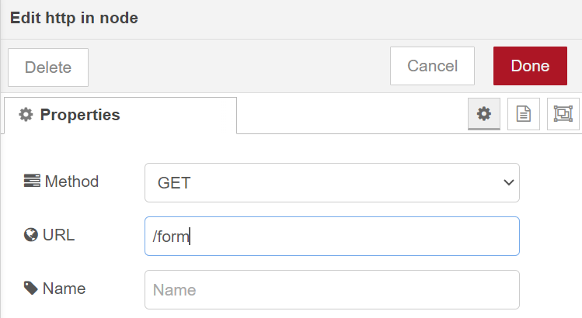
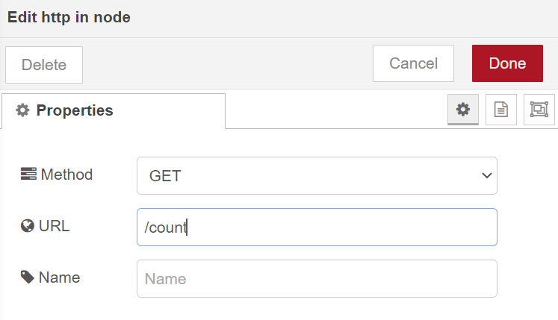
/form
/count

Slide 13
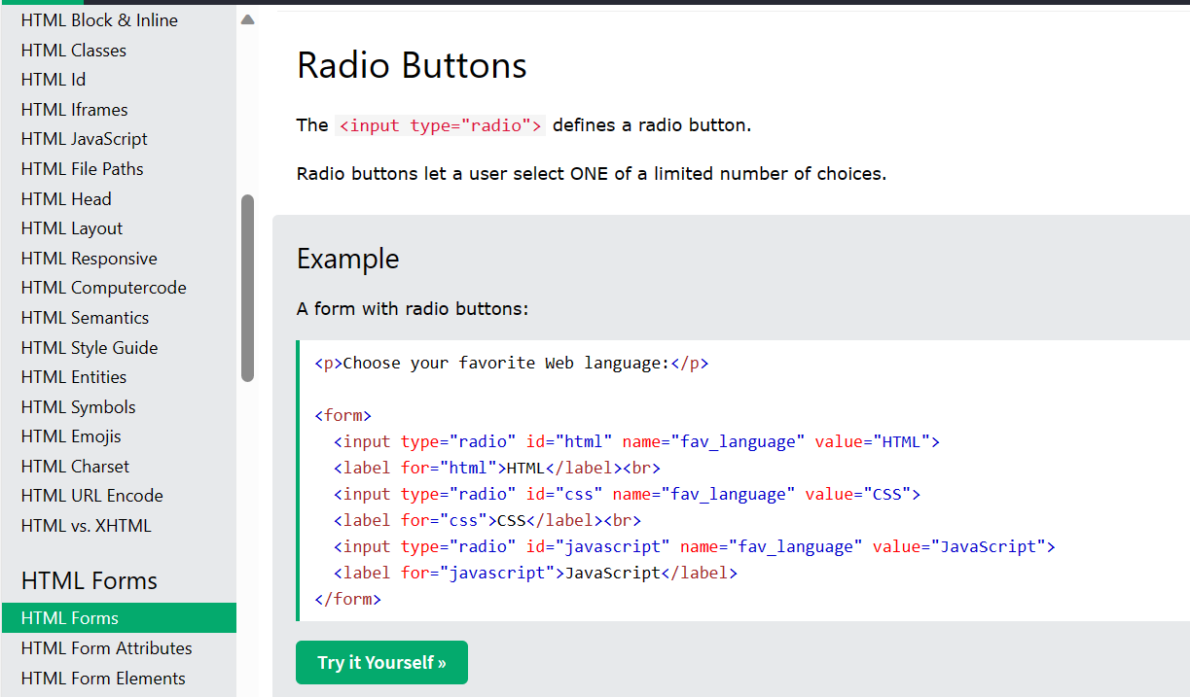
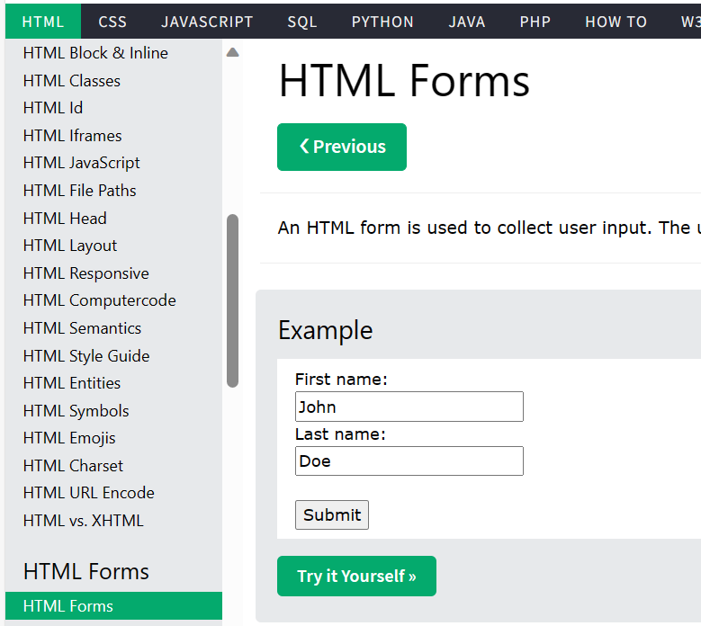
https://www.w3schools.com/html/html_forms.asp

Slide 14
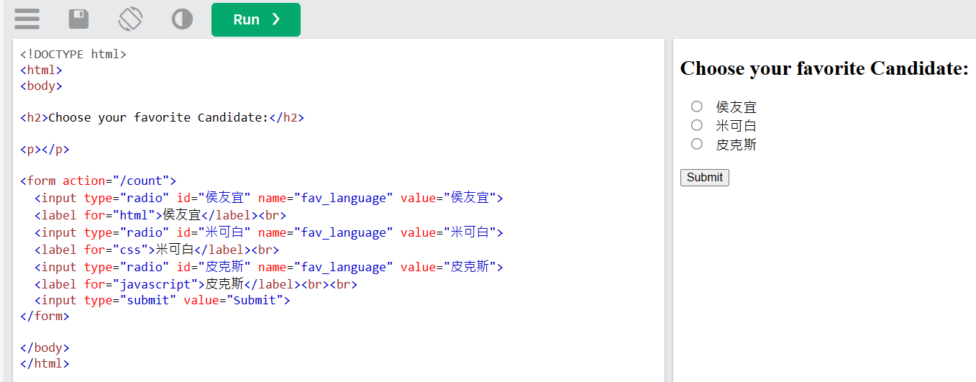
利用前一頁網頁改寫成自己的投票選單
copy

Slide 15
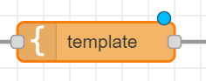
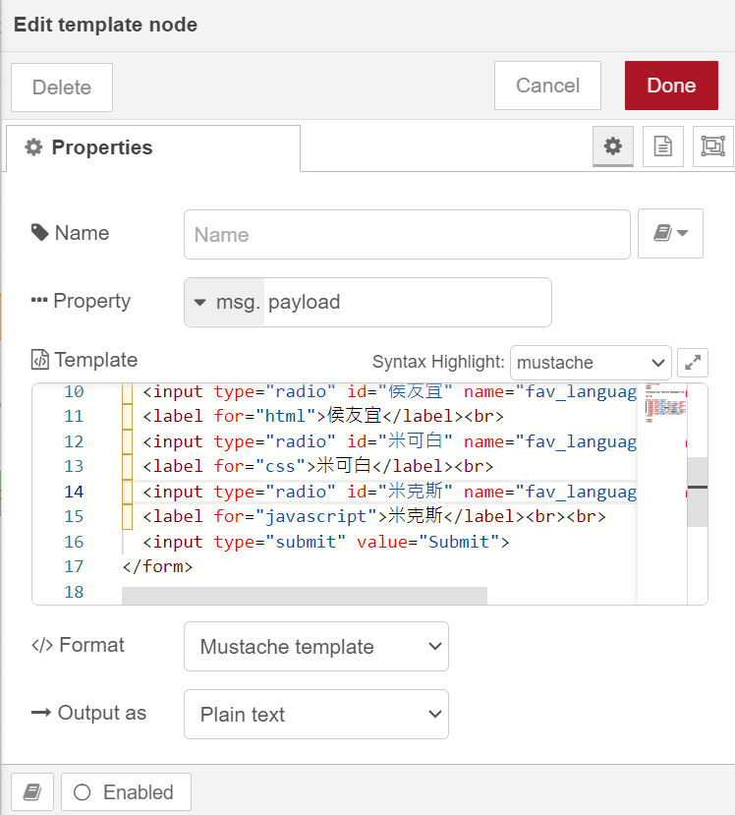
Paste

Slide 16

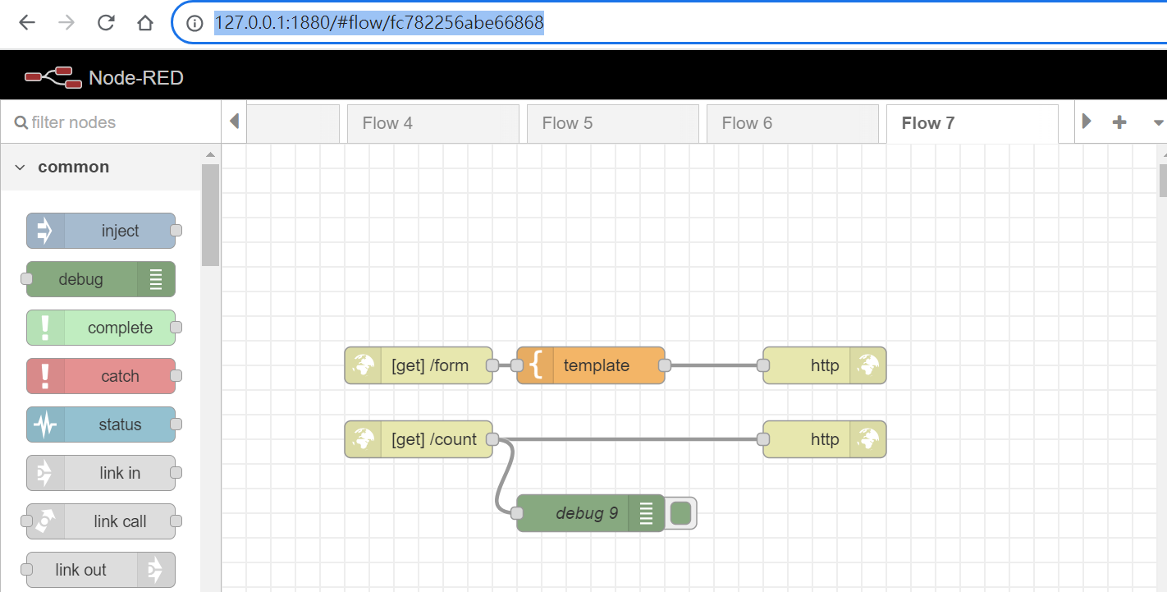
另開分頁並將網址改寫127.0.0.1:1880/form

Slide 17
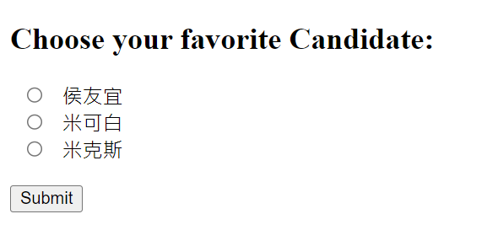
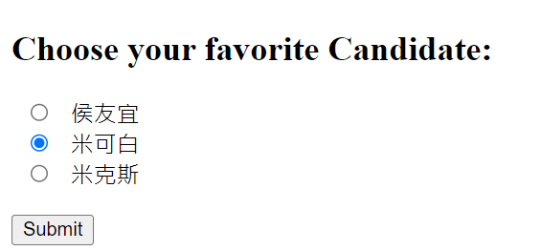
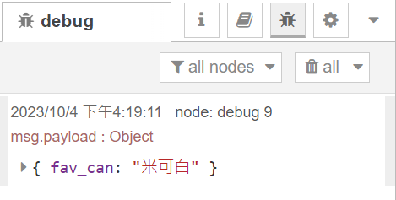
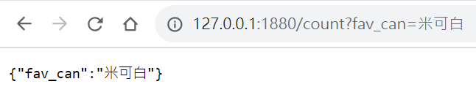
Showing your choice
debug

Slide 19
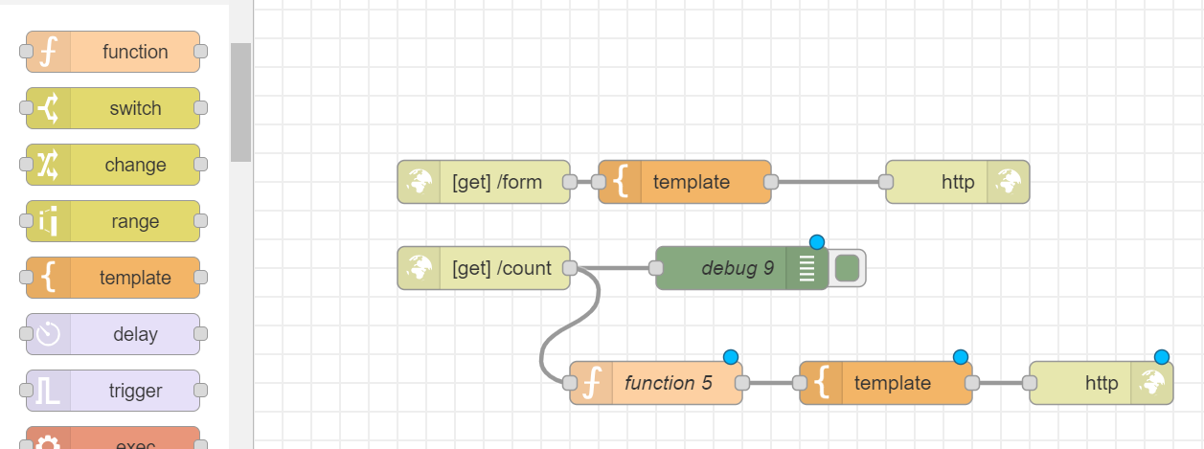
add a function node & a template node

Slide 20
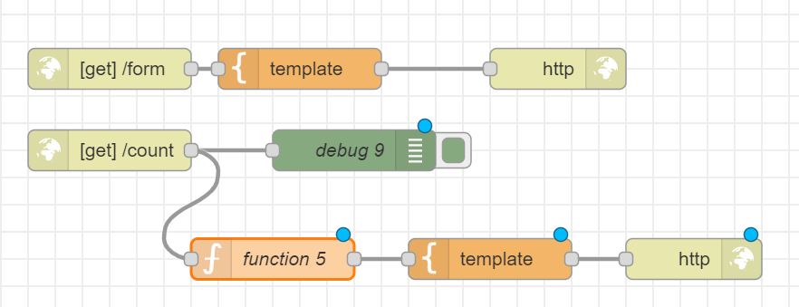
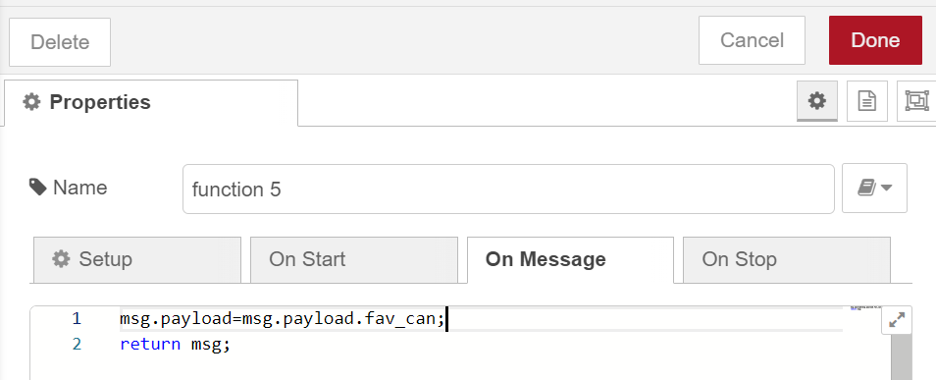
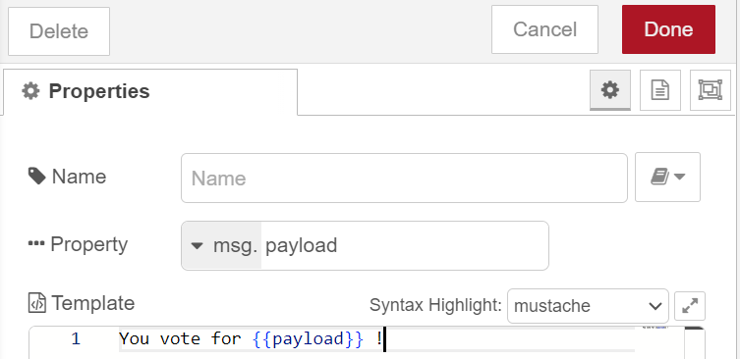

Slide 21
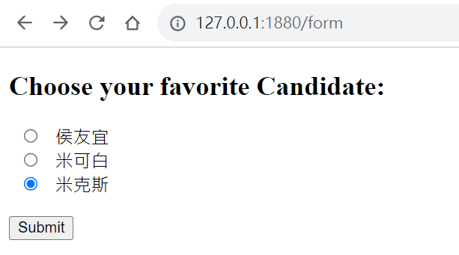
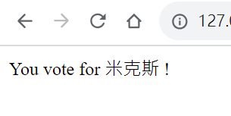

Slide 22
Exercise 4-4
Evaluate the voting results

Slide 23
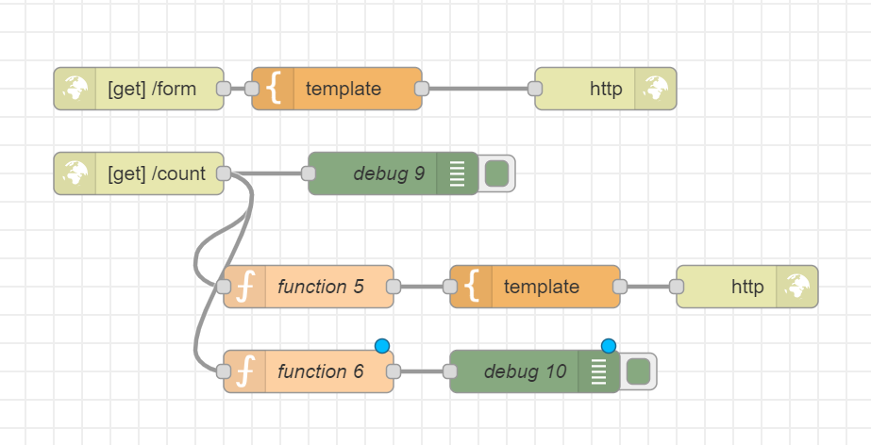
add a function node & a debug node
Edit

Slide 24
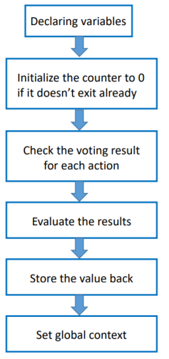
var d1=0;
var d2=0;
var d3=0;
var counter1 = context.get('counter1')||0;
var counter2 = context.get('counter2')||0;
var counter3 = context.get('counter3')||0;
if(msg.payload.fav_can == "侯友宜") {d1=1;}
else if (msg.payload.fav_can == "米可白") {d2 =1;}
else {d3 =1;}
counter1 = counter1 + d1;
counter2 = counter2 + d2;
counter3 = counter3 + d3;
context.set("counter1",counter1);
context.set("counter2",counter2);
context.set("counter3",counter3);
global.set("cou1",counter1);
global.set("cou2",counter2);
global.set("cou3",counter3);
msg.payload={"cou1":counter1, "cou2":counter2,"cou3":counter3};
return msg;

Slide 25
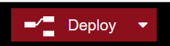
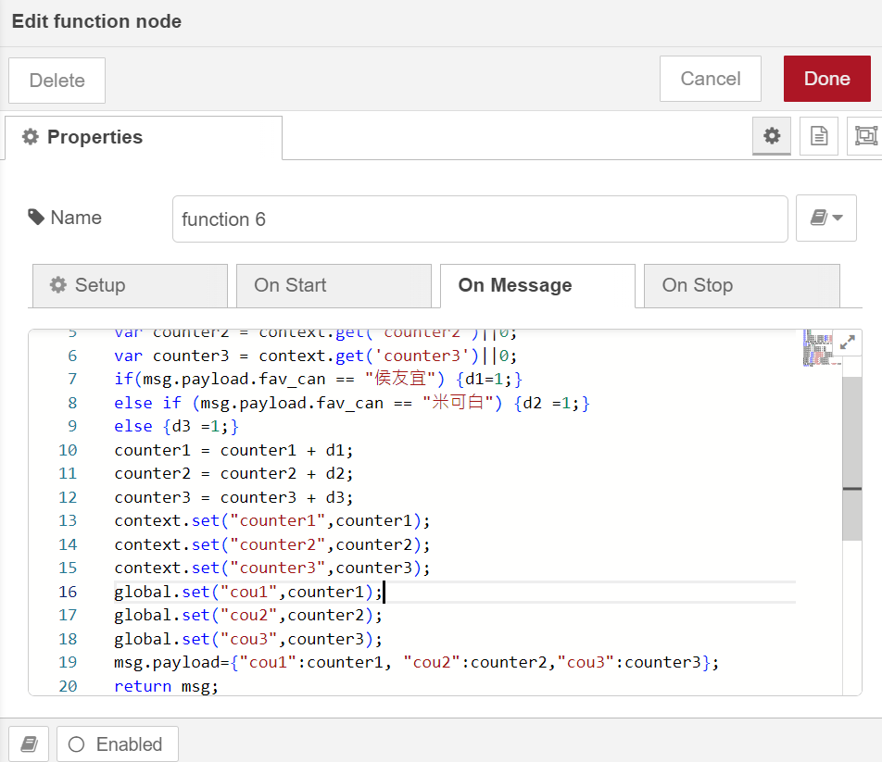
var d1=0;
var d2=0;
var d3=0;
var counter1 = context.get('counter1')||0;
var counter2 = context.get('counter2')||0;
var counter3 = context.get('counter3')||0;
if(msg.payload.fav_can == "侯友宜") {d1=1;}
else if (msg.payload.fav_can == "米可白") {d2 =1;}
else {d3 =1;}
counter1 = counter1 + d1;
counter2 = counter2 + d2;
counter3 = counter3 + d3;
context.set("counter1",counter1);
context.set("counter2",counter2);
context.set("counter3",counter3);
global.set("cou1",counter1);
global.set("cou2",counter2);
global.set("cou3",counter3);
msg.payload={"cou1":counter1, "cou2":counter2,"cou3":counter3};
return msg;

Slide 26
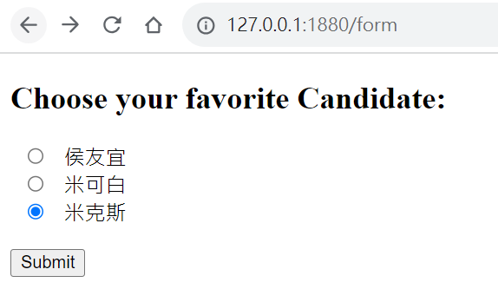
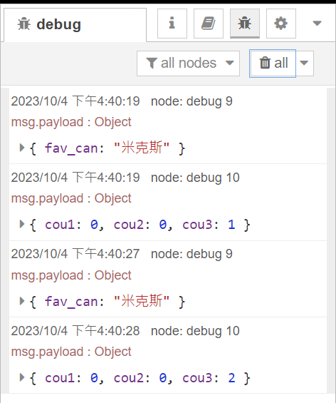
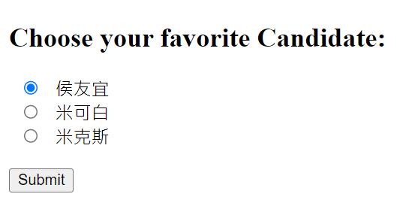
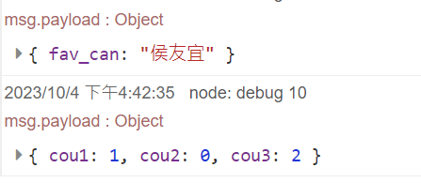
票數統計

Slide 27
Exercise 4-5
Visualize the voting results

Slide 28
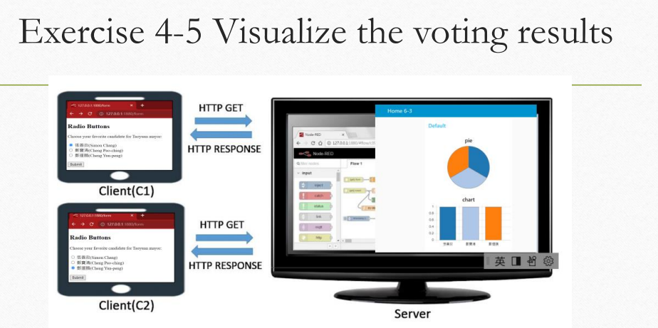

Slide 29
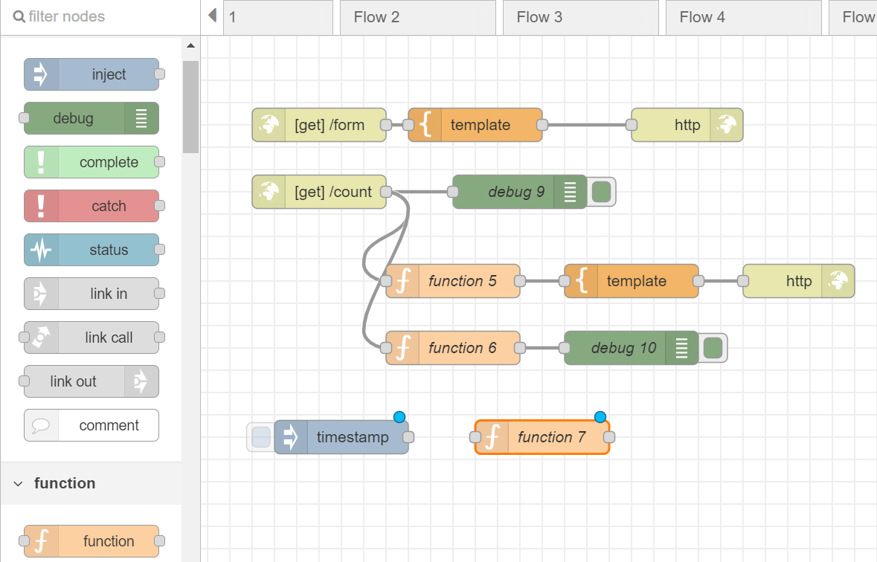
add a inject node & a function node

Slide 30
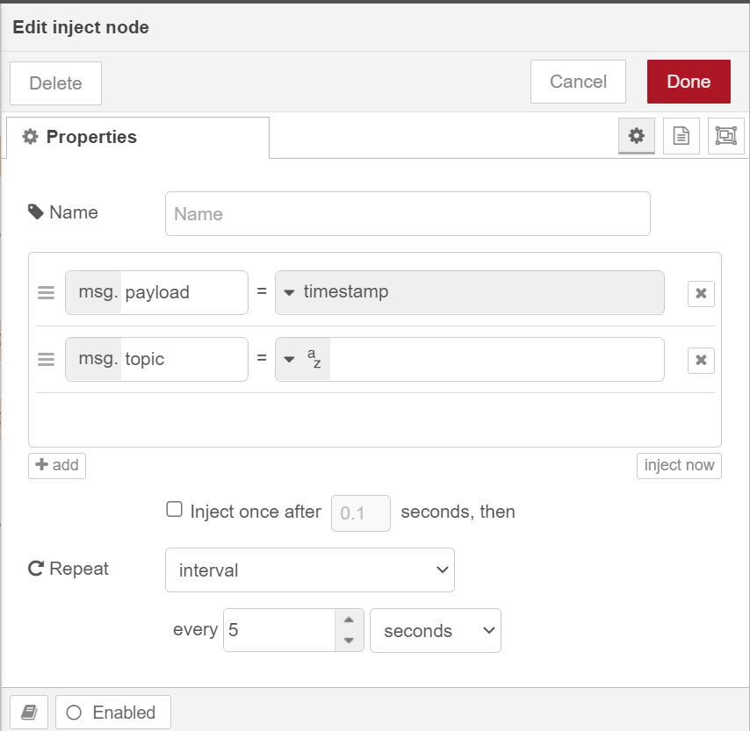
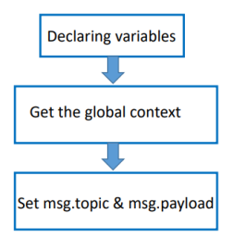

Slide 31
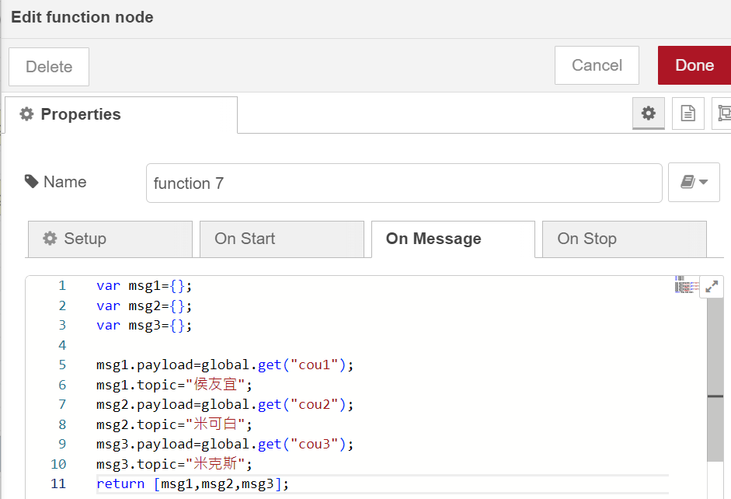
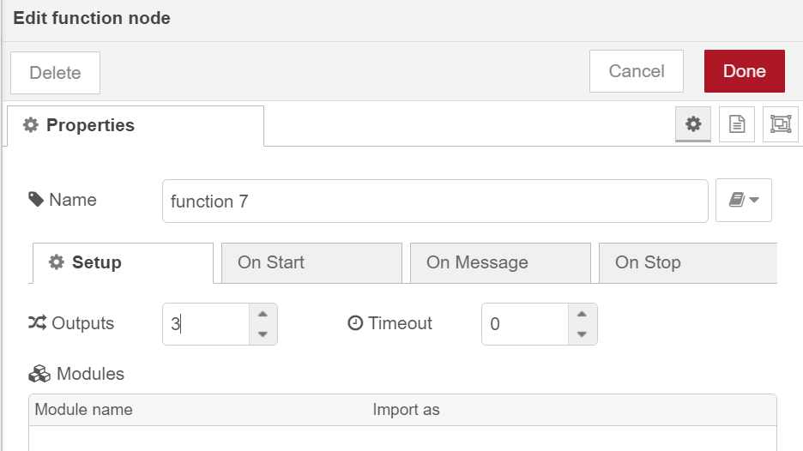
Edit function node

Slide 32
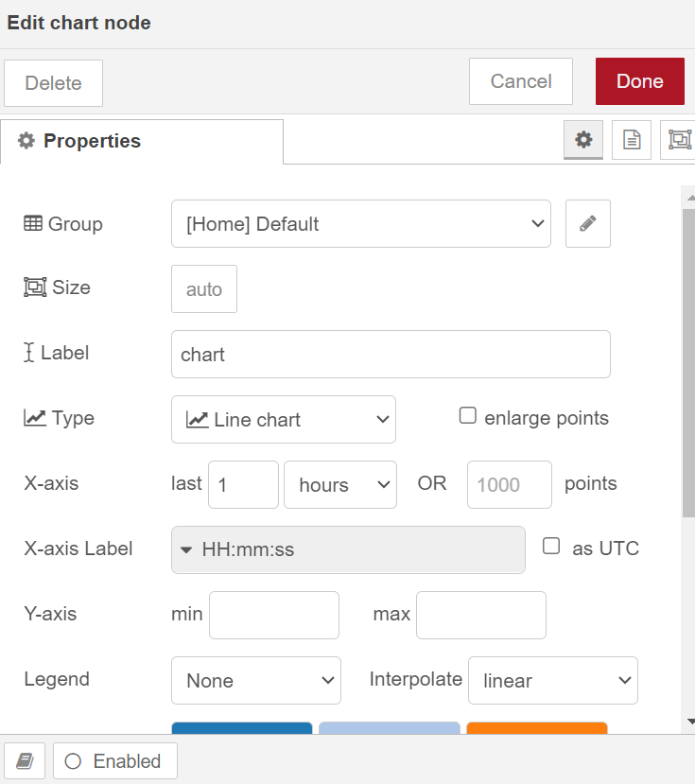
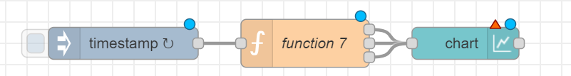

Slide 33
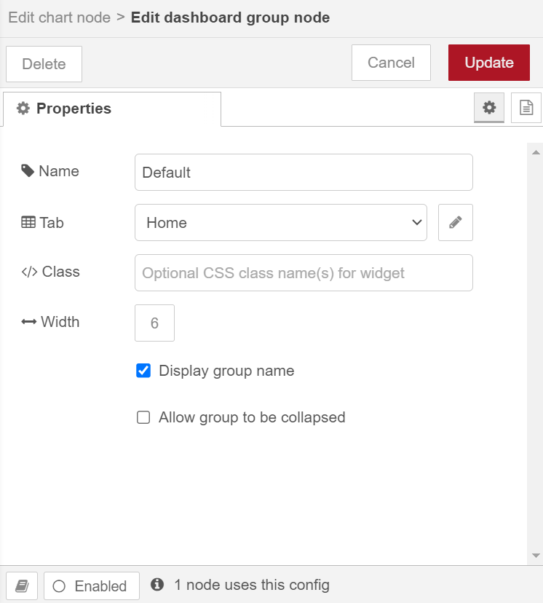


Slide 34


Bar chart

Slide 35


1
3
2

Slide 36

Result

Slide 37


Slide 38


pie
Pie chart

Slide 39


Slide 40
Homework 4-1
For an object : {firstName:"John",lastName:"Doe",age:50,eyeColor:"blue"}
Change the last one value to "red"

Slide 41

1
2
3

Slide 42

Trigger
click

Slide 43
Homework 4-2
Print the value of mag data when the mag > 4

Slide 44

抓取之前作業的檔案，也可至https://nodered.org/docs/tutorials/second-flow 複製程式碼import進來

Slide 45





Slide 46


Slide 47

Click

Slide 48


當mag值大於4時(先前switch node做的設定)，會印出mag的值

Slide 49
Homework 4-3
Design a voting system for four candidates.

Slide 50


增加form第四個候選人選單

Slide 51
增加第四個候選人計票紀錄
var d1=0;
var d2=0;
var d3=0;
var d4=0;
var counter1 = context.get('counter1')||0;
var counter2 = context.get('counter2')||0;
var counter3 = context.get('counter3')||0;
var counter4 = context.get('counter4')||0;
if(msg.payload.fav_can == "侯友宜") {d1=1;}
else if (msg.payload.fav_can == "米可白") {d2 =1;}
else if (msg.payload.fav_can == "米克斯") {d3 =1;}
else {d4 =1;}
counter1 = counter1 + d1;
counter2 = counter2 + d2;
counter3 = counter3 + d3;
counter4 = counter4 + d4;
context.set("counter1",counter1);
context.set("counter2",counter2);
context.set("counter3",counter3);
context.set("counter4",counter4);
global.set("cou1",counter1);
global.set("cou2",counter2);
global.set("cou3",counter3);
global.set("cou4",counter4);
msg.payload={"cou1":counter1, "cou2":counter2,"cou3":counter3,"cou4":counter4};
return msg;

Slide 52


增加第四個候選人計票結果

Slide 53

增加第四個候選人output連到chart and pie

Slide 54

127.0.0.1:1880/form

Slide 56


Slide 57


